Slide 1

Python games
By Lakshay Kumar

Slide 2
Basic introduction
GamingHub consist of 4 children’s games from which we can choose from. The games are made using tkinter and turtle libraries which are used for giving graphical output of the code.
Once we play the games, it calculates the time in which the games are made and calculates the money based on that time.

Slide 3

Need for Gamehub
Nowadays many children are in an addiction of violent games. It affects their behavioural patterns and makes them impatient.
The games of gamehub are a solution to that. Some games need fast reflexes to win while others don’t have a win-loss concept and are more of a relaxant to the children.

Slide 4


Smile Man
It is a game made with the use of tkinter library. I have made the various states of the smile man which are triggered at the events of hover(smile), clicking(laugh/tongue out), and even after not clicking for 5 seconds (sad).

Slide 5
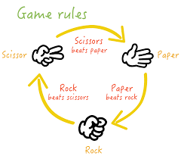
Rock Paper Scissor
It is a simple game made with the use of random function. The player inputs their choice and they are given the choice of the computer.
The game also shows the number of times you won and the number of times the computer won

Slide 6
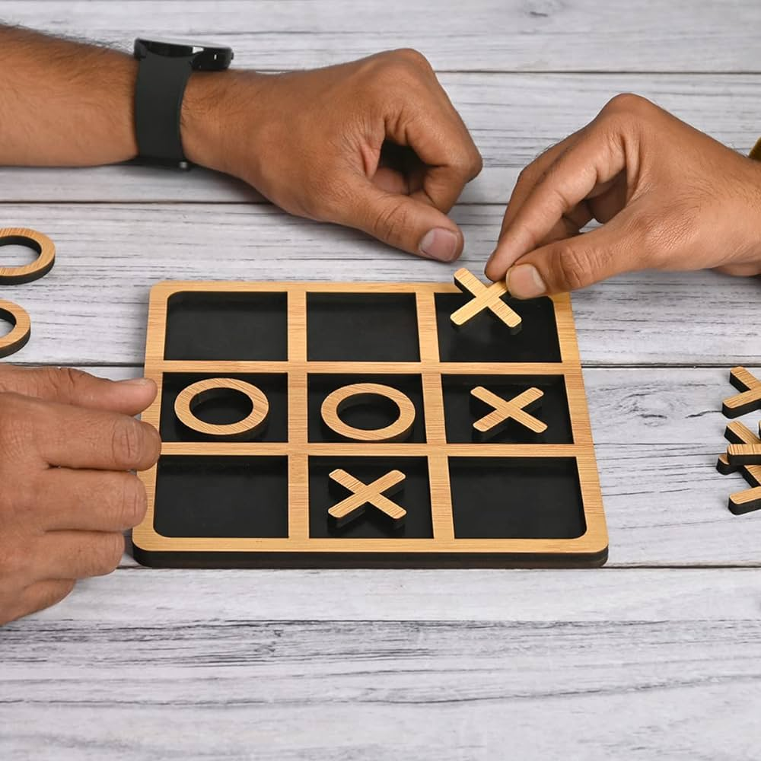
Tic Tac toe
It is another game made with the use of random function in python.
The game uses matrix for playing.

Slide 7
Fruit BAsket
It is a game made with the use of graphical libraries of python. The player is given 3 lives and he has to catch the fruits that are falling from the top. We have made the use of random function for the position of the fruits and we make the y coordinate of the fruit objects less with time.
The loss of fruits decreases the value of player lives( we have done this with the condition that when the y coordinate of the object become negative, we decrease the number of lives with one)

Slide 8

Future scope
The games are a good way for children to pass time and relax for a while. The project can help the parents do a check and restriction on the amount of time their children paly the game as we have used the time function in these and we can add the functionality to quit the games when the time_elapsed exceeds the time input by the parents.
This game can also work as a one stop to all the games the children play by adding more games in it.

Slide 9


